Slide 1


SLEEP HEALTH
& LIFESTYLE
GROUP THREE PRESENTATION

Slide 2





BLERJ RESEARCH TEAM
RITA ACQUAH
BERNICE AKOTO
ERIC INKOOM AYITEY
JESSIE PRAH
LINDA SELI MANTEY
SENIOR DATA ANALYST
ASSOCIATE DATA ANALYST
LEAD DATA ANALYST
ASSOCIATE DATA ANALYST
PROJECT LEAD

Slide 3

Overview
KEY OBJECTIVES
This dataset provides a comprehensive view of sleep patterns and lifestyle factors among active working professionals.
We will explore vital metrics including sleep duration, quality, stress levels, and BMI categories.
The analysis will examine the correlation between lifestyle habits, cardiovascular health (blood pressure, heart rate), and the prevalence of sleep disorders.
This study is specifically targeted toward understanding the sleep health of the active working class.

Slide 4
Sleep Duration (hours): The number of hours the person sleeps per day.
Quality of Sleep (scale: 1-10): A subjective rating of the quality of sleep, ranging from 1 to 10.
About The Dataset
Physical Activity Level (minutes/day): The number of minutes the person engages in physical activity daily.
Stress Level (scale: 1-10): A subjective rating of the stress level experienced by the person, ranging from 1 to 10.
BMI Category: The BMI category of the person (e.g., Underweight, Normal, Overweight).
Blood Pressure (systolic/diastolic): The blood pressure measurement of the person, indicated as systolic pressure over diastolic pressure.
Daily Steps: The number of steps the person takes per day.
KEY VARIABLES
Source : Kaggle
Sleep Disorder: The presence or absence of a sleep disorder in the person (None, Insomnia, Sleep Apnea).

Slide 5

RESEARCH QUESTIONS
Which Occupation has the most stress level?
What is the distribution of sleep disorder across gender?
What is the gender distribution against BMI?
What is the correlation between the average blood pressure and the quality of sleep?
What is the BMI against Age Group?
What is the relationship between the stress level and sleep duration?
What is the correlation between Stress level and Blood Pressure?

Slide 6
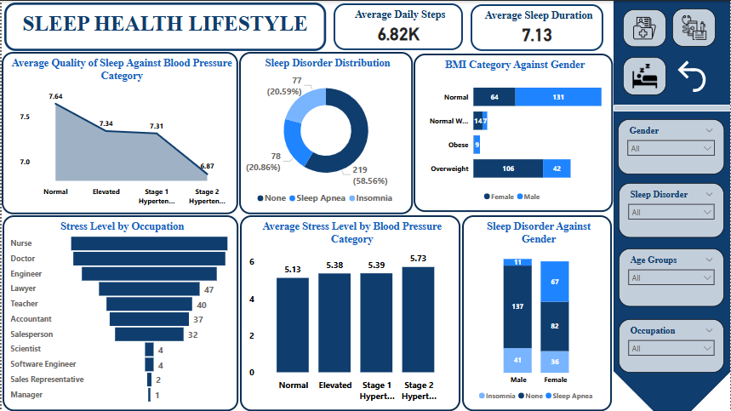

Slide 7

FINDINGS & INSIGHTS
FROM OUR FINDINGS:
FROM OUR FINDINGS:
Nurses had the most Stress level
We observed a higher incidence of insomnia in males and a higher incidence of sleep apnea in females within the dataset.
A higher proportion of females were classified as overweight compared to males.
Sleep quality has an impact on blood pressure levels.
There was a significant increase in overweight individuals within the population aged 40 and older.
Shorter sleep duration was associated with higher stress levels.
Higher stress levels are associated with higher blood pressure readings.

Slide 8

Physical activities are encouraged to maintain a healthy weight.
Consuming nutrient-rich foods supports the body's ability to regulate stress responses.
Maintain consistent sleep schedule.
Recommendations

Slide 9
Talk to Us
E-mail Address
info@blerj.com
Phone Number
+233 - 24 - 123 - 4567

